Slide 1
Introduction to Global Securities Market
国际证券市场简介
College of Software Technology, Zhejiang University
浙江大学软件学院
May 19-20, 2018
Edward Li, CFA, FRM
ecli_99@yahoo.com

Slide 2
Learning Objectives
  After studying this session, you should be able to:
    Gain a solid understanding of fundamental concepts related to Foreign Exchange including markets, participants, quotation and conventions, trading instruments and basic calculations
    Convert exchange rates based on the quotations
    Calculate arbitrage opportunities if any
    One quiz is to be given

Slide 3
What is Foreign Exchange?
Foreign Exchange (also known as "forex" or "FX") is the exchange of one country's currency for another. All foreign exchanges are determined by a rate of exchange, or a ratio valuing one currency against another.
An Exchange Rate is a ratio that describes how many units of one currency you can buy per unit of another currency.
e.g. on May 2, 2011
USD 1 = EUR 0.67431
Or
EUR 1 = USD 1.483

Slide 4
What is Foreign Exchange?
In finance, the exchange rate between two currencies specifies how much one currency is worth in terms of the other.
For example an exchange rate of 80 Japanese Yen to the Dollar means that ¥80 is worth the same as $1.
An exchange rate is also known as a foreign exchange rate, or FX rate.
Each sovereign state issues and manages its own currency through a national central bank. The exception is the Euro Zone, which covers multiple countries

Slide 5
Foreign Exchange Market
The FX market facilitates:
  Conversion of purchasing power from one currency to another; bank deposits of foreign currency; credit denominated in foreign currency; foreign trade financing; trading in foreign currency options & futures, and currency swaps
Unlike stock exchanges, there is no central market place
  World-wide linkage of bank currency traders, non-bank dealers (IBanks, insurance companies, etc.), and FX brokers—like an international OTC market
  Trading conduct over the counter
Largest and most liquid financial market in the world
  Daily trading volumes reached US$5.5 trillion in 2014 vs $1.7 trillion in 1998
  Trading occurs 24 hours a day, five days a week, with currencies being traded worldwide among the major financial centers of London, New York, Tokyo, Zürich, Frankfurt, Hong Kong, Singapore, Paris and Sydney -spanning most time zones.
  London is the largest FX trading center

Slide 6
Foreign Exchange Market
Participants
  Banks
  Commercial companies
  Central banks
  Investment management firms
  Hedge funds as speculator
  Retail
Only about 15% of FX is directly driven by cross-border trade in goods and services. Approximately 85% is driven by capital transactions conducted by banks for financial engineering and speculation.

Slide 7
Foreign Exchange Market
Most liquid Market
Exchange rates are highly sensitive to a great variety of factors
Round-the-clock market
Main international Banks continuously provide both bid and ask rates
Exchange rate fluctuations are usually caused by actual monetary flows as well as anticipations on global macroeconomic conditions
Traded in pairs like, USD/CHF, USD/JPY, EUR/USD, GBP/USD, USD/CAD etc

Slide 8
Foreign Exchange Market
Average daily international foreign exchange trading volume was $5.5 trillion in 2014 according to the BIS study:
  $1.5 trillion spot Foreign Exchange
  $2.5 trillion outright forwards, FX swaps other derivatives
  Volumes by countries
    UK, 36.7%
    US, 17.9%
    Japan, 6.2%

Slide 9
Top 5 Most Traded Currencies
RANK CURRENCY CODE SYMBOL
1 United States Dollar USD $
2 Euro EUR €
3 Japanese Yen JPY ¥
4 British Pound Sterling GBP £
5 Swiss Francs CHF

Slide 10
Foreign Exchange Market
36 major currencies, such as the U.S. dollar, the Japanese yen, the Euro, and the British pound are determined largely by market forces.
50 countries, including China, India, Russia, and Singapore, adopt some forms of “Managed Floating” system.
41 countries do not have their own national currencies!
40 countries, including many islands in the Caribbean, many African nations, UAE and Venezuela, do have their own currencies, but they maintain a peg to another currency such as the U.S. dollar.
The remaining countries have some mixture of fixed and floating exchange-rate regimes.

Slide 11
The Euro
Product of the desire to create a more integrated European economy.
Eleven European countries adopted the Euro on January 1, 1999:
  Austria, Belgium, Finland, France, Germany, Ireland, Italy, Luxembourg, Netherlands, Portugal, and Spain.
The following countries opted out initially:
  Denmark, Greece, Sweden, and the U.K.
Euro notes and coins were introduced in 2002
Greece adopted the Euro in 2001
Slovenia adopted the Euro in 2007

Slide 12
Foreign Exchange Market
As per BIS study, in FX spot market heavily traded products are:
    EUR/USD -28 %
    USD/JPY -17 %
    GBP/USD (also called Pounds/cable) -14 %
US currency was involved 89% of transactions, followed by the euro (37%), the yen (20%) and sterling (17%)
The foreign exchange market is thus still overwhelmingly dollar-centered

Slide 13
Foreign Exchange Market
Round the clock Market –Market opens from Sydney –Tokyo -Hong Kong –Singapore –Dubai –London –Frankfurt –Paris -New York
FX market is open 24 hours a day throughout the week.
Closing worldwide Friday afternoon at 5pm New York time, ie 2100 GMT, and reopening Sunday 1900 GMT when Wellington, New Zealand opens on their Monday morning

Slide 14
FX Market Structure & Participants
The FX market is a two-tiered market:
  Interbank Market (Wholesale)
    Accounts for about 83% of FX trading volume—mostly speculative or arbitrage transactions
    About 100-200 international banks worldwide stand ready to make a market in foreign exchange
    FX brokers match buy and sell orders but do not carry inventory
  Client Market (Retail)
    Accounts for about 17% of FX trading volume
Market participants include international banks, their customers, non-bank dealers, FX brokers, and central banks

Slide 15
Exchange Rate
The exchange rate between two currencies specifies how much one currency is worth in terms of the other.
An exchange rate is also known as a foreign-exchange rate, forex rate or FX rate.
For example an exchange rate of 80 Japanese yen (JPY, ¥) to the United States dollar (USD, $) means that JPY 80 is worth the same as USD 1

Slide 16
Exchange Rate
In-class exercise:
If you read that the Japanese yen is trading at $0.01232, how many yen will each dollar buy?
  0.01232
  1.232
  81.169
  8.119

Slide 17
Exchange Rate
In-class exercise:
The U.S. dollar was recently quoted at CHF0.8594 (Swiss francs). If you have placed an order for CHF 50,000 worth of watches from a Swiss watch dealer, how many dollars will this order cost?
  $58,180
  $42,970
  $50,000
  $52,180

Slide 18
Exchange Rate
A currency appreciates when it rises in value relative to another foreign
currency and likewise a currency depreciates when it falls in value relative to
another foreign currency.
For example, If the Mexican Peso moves from $0.09 to $0.10, the Peso has
appreciated – each Peso can buy $0.10 now instead of $0.09.
For US dollar, it has depreciated. By how much?

Slide 19
Determinants of Exchange Rates
Demand, Supply, and Equilibrium in the FX Market: Exchange rates are determined by supply and demand
Changes in Exchange Rates are caused by:
  Differential Income Growth among nations will cause those nations with the highest income growth to demand more imported goods. The heightened demand for imports will increase demand for foreign currency – appreciating the foreign currency and depreciating the domestic currency.
  Differential Inflation Rates will also cause a movement in exchange rates.
  Differential Interest Rates will cause a flow of capital into those countries with the highest available real rates of interest.

Slide 20
Determinants of Exchange Rates
What will cause a nation’s currency to appreciate?
Slow growth of income relative to one’s trading partners will cause imports to lag behind exports
A rate of inflation that is lower than that of one’s trading partners
Domestic real interest rates that are greater than real interest rates abroad

Slide 21
Determinants of Exchange Rates
What will cause a nation’s currency to depreciate?
Rapid growth of income relative to one’s trading partners that stimulates imports relative to exports
A rate of inflation that is higher than that of one’s trading partners
Domestic real interest rates that are lower than real interest rates abroad

Slide 22
Determinants of Exchange Rates
In-class exercise:
If the Mexico Peso moves from $0.09 to $0.10, which of the following is true?
  It becomes more expensive for Americans to buy Mexican goods
  It becomes less expensive for Mexicans to buy American goods
  Mexican industry becomes less competitive with Americans in the U.S. market
  All of the above are true

Slide 23
Bid/Offer Spread
Like any other market, there is a Bid/Offer Spread –Difference between buying and selling prices.
Market maker buys at a lower price and sells at a higher price. For example: 1 USD = 1.3273/1.3275 means, I as a market maker, buy 1 USD at 1.3273 CHF and sell 1 USD at 1.3275 CHF.
But, this is narrow spread only for interbank market or wholesale market.
For Individual currency speculators, spread is more, say, 1 USD = 1.3250/1.3300 CHF

Slide 24
Bid/Offer Spread
A bid price is the exchange rate the bank is willing to buy a currency at.
An offer/ask price is the exchange rate the bank is willing to sell at a currency
at.
In-class exercise:
You receive a bid-ask quote for pesos 8.00-8.50. If you have $100, how many pesos will you be able to buy?
  118
  125
  800
  850
What will happen if you hold pesos and want to convert back to USD?

Slide 25
Exchange Rate Quotation
An exchange rate quotation is given by stating the number of units of a counter currency that can be bought in terms of 1 Base currency.
Counter Currency is also called as Given Currency or Variable Currency.
Two types of Quotations :
  1. Market Quotation
  2. Inverted Quotation

Slide 26
Exchange Rate Quotation
Market Quotations are the quotations which market players use in Trading and is popularly quoted across all the Trading centers.
    e.g.: 1 USD = 1.2025 CAD
    1 EUR = 1.1880 USD
    1 GBP = 1.7550 USD
Inverted Quotations are the reverse of the Market Quotations. Inverted quotations are reciprocal to Market Quotations.
    e.g.: 1 CAD = 0.8316 USD
    1 USD = 0.8417 EUR
    1 USD = 0.5698 GBP

Slide 27
FX Quotation
Quote Pair : USD / HKD
Bid / Ask (offer) : 7.7753 / 7.7780
Spread point: 27 basis points
Quote convention: the last two digits of decimal point (e.g. 53, 80)
  Direct quote: Foreign currency/Local currency e.g. In Hong Kong, the quote: USD/HKD=7.7753/7.7780
  Indirect quote: Local currency/Foreign currency e.g. In Sydney, the quote: AUD/USD=0.7358/0.7361

Slide 28
Exchange Rate Quotation
In foreign exchange markets, the base currency is the first currency in a currency pair.
􀂃Exchange rates are quoted in per unit of the base currency
􀂃Currently the euro is the dominant base currency against all other global currencies.
􀂃Many market participants use the expressions "currency 1" and "currency 2", where one unit of CCY1 equals a variable number of units of CCY2.

Slide 29
Exchange Rate Regime
Fixed Exchange Rate : is a type of exchange rate regime wherein a currency's value is matched to the value of another single currency or to a basket of other currencies, or to another measure of value, such as gold.
􀂃For Ex: Chinese RMB use to be stable for many years around 1 USD = 8.08 ( between 8.07 and 8.12)
􀂃Floating exchange rate or a flexible exchange rate is a type of exchange rate regime where in a currency's value is allowed to fluctuate according to the foreign exchange market.
􀂃For Ex: EUR/USD, GBP/USD, AUD/USD, USD/CHF etc.

Slide 30
Fluctuations in Exchange Rate
Demand and Supply
Country’s level of business activity and FOREX RESERVES.
Gross Domestic Product (GDP) and Employment Levels
Volume of Trade / Exports & Imports
Trade Deficit/Current Account Deficit
Interest Rates / Monetary Policy
Political stability

Slide 31
Spot Exchange
The exchange of two currencies for immediate delivery, normally with T+2.
Some spot exchanges can be delivered on the same day (T+0) or “Value TOM-tomorrow” (T+1), depending on the country market practices. Eg. USD/CAD
  Example:
  - Trade Date: May 13th, 2005
  - Value Date / Settlement Date : May 15th, 2005

Slide 32
Spot Exchange
The spot market involves the immediate purchase or sale of foreign exchange
  Cash settlement occurs 1-2 days after the transaction
Currencies are quoted against the US dollar
Interbank FX traders buy currency for their inventory at the bid price
Interbank FX traders sell currency for their inventory at the ask price
Bid price is less than the ask price
Bid-ask spread is a transaction cost

Slide 33
FX - Spot
Reuters Screen for FX Spot prices:
Currency Pair BID OFFER Bank High Bid Low Bid
EUR/USD 1.1880 1.1882 JP Morgan 1.1922 1.1860
GBP/USD 1.7460 1.7462 Deutsche Bk 1.7475 1.7380
USD/JPY 116.85 116.88 HSBC Bank 117.11 116.57
AUD/USD 0.7275 0.7278 RB of Aus 0.7318 0.7265
USD/CAD 1.1715 1.1718 HSBC Bank 1.1734 1.1692
USD/CHF 1.3140 1.3145 Std. Chd Bk 1.3155 1.3102
USD/INR 45.21 45.22 State Bank 45.34 45.18
USD/SGD 1.1661 1.1664 Deutsche Bk 1.1686 1.1654

Slide 34
The Spot Market
Trade Date: The date on which the deal is concluded between the two counterparties.
Value Date: The date of settlement of currencies between each other. Spot Date is the value date for all FX Spot deals I.e, usually two working days.
Bid: Is the rate at which market maker buys the Base Currency
Offer / Ask : Is the rate at which market maker sells the Base Currency
Base Currency 1 EUR = 1.1880 USD Variable Currency

Slide 35
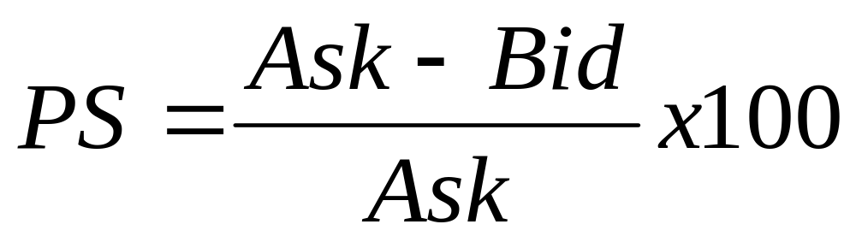
The Spot Market
Percent Spread Formula (PS):

Slide 36
The Spot Market – Direct Quotes
US dollar price of 1 unit of foreign currency—$ are in the numerator (foreign currency is priced in terms of dollars)
  $/€ = 1.5000 (1€ costs $1.5000)
  $/£ = 2.0000 (1£ costs $2.0000)
Currency changes
  Suppose that today, $/€ = 1.5000 and in 1 month, $/€ = 1.5050
    The $ has depreciated in value
    Alternatively, the € has appreciated in value
  Suppose that today, $/£ = 2.0000 and in 1 month, $/£ = 1.9950
    The $ has appreciated in value
    Alternatively, the £ has depreciated in value

Slide 37
The Spot Market – Indirect Quotes
Foreign currency price of $1—$ are in the denominator (US dollar is priced in terms of foreign currency)
  €/$ = 0.6667 ($1costs €0.6667)
  £/$ = 0.5000 ($1 costs £0.5000)
Currency changes
  Suppose that today, €/$ = 0.6667 and in 1 month, €/$ = 0.6600
    The $ has depreciated in value
    Alternatively, the € has appreciated in value
  Suppose that today, £/$ = 0.5000 and in 1 week, £/$ = 0.5050.
    The $ has appreciated in value
    Alternatively, the £ has depreciated in value

Slide 38
The Spot Market – Conventions
Denote the spot rate as S
For most currencies, use 4 decimal places in calculations
  With exceptions: i.e. S(¥/$)=109.0750, but S($/¥)=0.009168
If we are talking about the US, always quote spot rates as the dollar price of the foreign currency
  i.e. as direct quotes, S($/€), S($/C$), S($/£), etc
Increase in the exchange rate ⇒ the US dollar is depreciating
  Costs more to buy 1 unit of foreign currency
Decrease in the exchange rate ⇒ the US dollar is appreciating
  Costs less to buy 1 unit of foreign currency

Slide 39
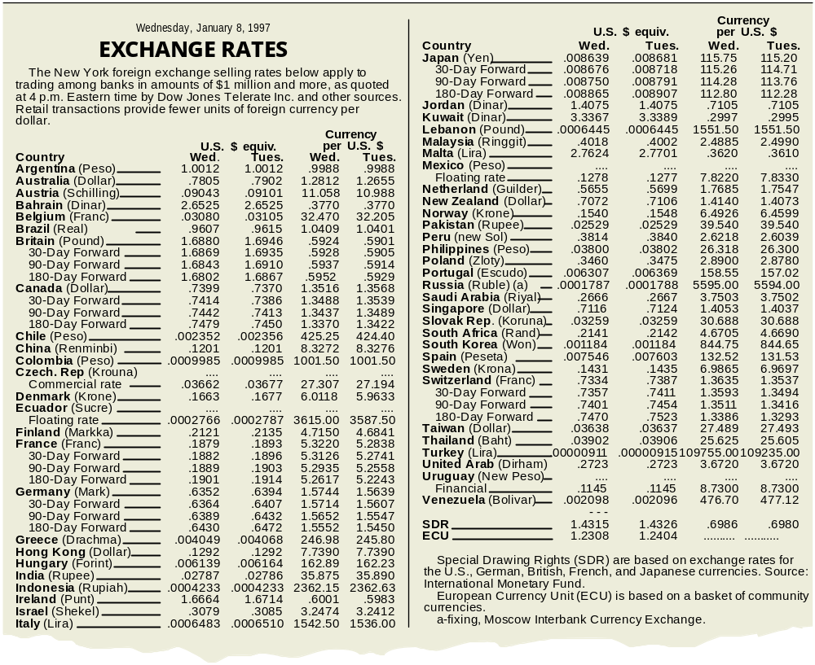
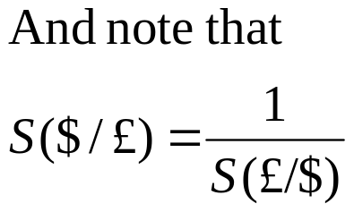
The Spot Market
US dollar price:
S($/£)=1.6880
£1 costs $1.6880
UK pound price:
S(£/$)=0.5924
$1 costs £0.5924

Slide 40
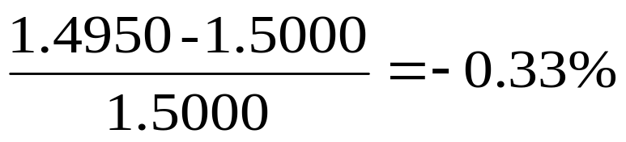
The Spot Market
The current exchange, S($/€)=1.5000. In 1 month, it is S(€/$)=0.6689
  Has the US dollar appreciated or depreciated?
  By what % has the exchange rate changed?
Convert S(€/$)=0.6689 to:
1/S(€/$)=S($/€)=1.4950.
  Now we see that the exchange rate has decreased ⇒ US dollar has appreciated.
  The % change per month is:

Slide 41
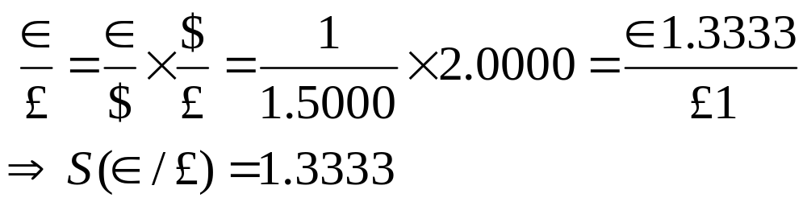
Cross Exchange Rates
The exchange rate between 2 currencies where neither currency is the US dollar
We know the dollar rates. What if we want to know other rates, i.e. S(€/£) ?
  Calculate cross-rates from dollar rates
  S($/€)=1.5000 and S($/£)=2.0000. What is S(€/£), i.e. the € price of £?

Slide 42
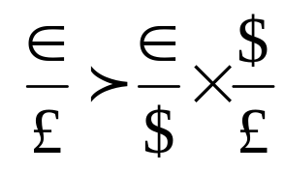
Cross Exchange Rates
Cross-rates must be internally consistent; otherwise arbitrage profit opportunities exist.
Suppose that:
A profit opportunity exists. Either S(€/£) is too high or S(€/$) or S($/£) is too low.
How does this work?
Sell high and buy low.

Slide 43
Cross Exchange Rates Example
Bank1: S($/¥)=0.0084; Bank2: S($/€)=1.0500; Bank3: S(€/¥)=0.0081.
The implied cross rate between Bank 1 and 2 is: S(€/¥)=0.0080.
You have ¥1,250,000. What should you do?
  Go to Bank 3.
  Convert ¥1,250,000 to €10,125.00 @ 0.0081
  Go to Bank 2.
  Convert €10,125 to $10,631.25 @ 1.0500.
  Go to Bank 1.
  Convert $10,631.25 to ¥1,265,625.00 @ (1/0.0084)
  The initial ¥1,250,000 becomes ¥1,265,625. You earn a risk-free profit of ¥15,625, or 1.25%.
Sell ¥ high!
Buy ¥ low!

Slide 44
Cross Exchange Rates Example
In-class exercise (hint: cross division formula is used):
The peso quote is 8.00-8.10. The mark quote is 2.00-2.10. What is the peso/mark bid-ask?
  4.00-4.05
  3.81-4.05
  3.81-3.86
  2.47-2.63

Slide 45
The Forward Market
Forward market involves contracting today for the future purchase or sale of foreign exchange
Forward prices are quoted the same way as spot prices
Denote the forward price maturing in N days as F_{N}
  i.e. F₃₀($/£), F₁₈₀($/€), F₉₀(€/ ¥), etc
The forward dollar price of the euro can be:
  Same as the spot price
  Higher than the spot price (euro at a premium)
  Lower than the spot price (euro at a discount)

Slide 46
FX Forward
Currency forward contracts, also known as "outright forward”, is the contract that holders are obligated to buy or sell the currency at a specified price, at a specified quantity, and on a specified future date.
  Forward is quoted in premium/discount e.g. USD/HKD Spot = 7.7753 / 7.7780, 1 month forward points = 24/28 (in premium)
  USD/HKD 1m forward = 7.7777/7.7808

Slide 47
FX Forward Transactions
What is Premium / Discount ?
  Premium / Discount are always quoted in pips in FX Market.
  In FX quotations, fourth decimal is a pip ( 0.0001 is one pip) except in USD/JPY where second decimal is a pip ( 0.01)
  When Base Currency is said to be in PREMIUM, against Variable Currency, that means, Rate of Interest is LOWER for Base currency compared to that of variable currency for the period. In Example 1, EUR interest for 1 month is 2.50% and USD interest for 1 month is 4.50%. So, EUR is in PREMIUM.
  When Base Currency is said to be in DISCOUNT, against Variable Currency, that means, Rate of Interest is HIGHER for Base currency compared to that of variable currency for the period. In Example 2, USD interest for 6 months is 5.00% and CHF interest for 6 months is 1.50%. So, USD is in DISCOUNT against CHF.

Slide 48
FX Forward Transactions
In-class exercise:
The current spot rate quote is 7HKD/$. A forward discount of 0.02 would reflect a forward price of:
  7.04
  6.96
  7.02
  6.98

Slide 49
FX Forward Transactions
What is Premium / Discount ????
How to calculate PREMIUM or DISCOUNT?
    FX spot rates, fx Forward rates and interest rates are interrelated by the interest rate parity (IRP) principle. This principle is based on the notion that there should be no arbitrage opportunity between the FX spot market, FX forward market, and the term structure of interest rates in the two countries.
    Premium or Discount are nothing but, loading of interest rates on respective currencies in a pair from the spot date till forward date to arrive at Forward rates.

Slide 50
FX Forward
Non-Deliverable Forwards (NDF)
  An NDF is a short-term committed forward ‘cash settlement’ currency derivative instrument.It is essentially an outright (forward) FX contract whereby on the contracted settlement date, profit or loss is adjusted between the two counterparties basing on the difference between the contracted NDF rate and the prevailing spot FX rates on an agreed notional amount.
  No actual movement of the principal amounts
  Every NDF has a fixing date and a settlement (delivery) date.The fixing date is the day and time whereby the comparison between the NDF rate and the prevailing spot rate is made. The settlement date is the day whereby the difference is paid or received

Slide 51
FX SWAP
An FX swap is a combined spot and forward transaction with the same counterparty, concluded at the same time.
An FX Swap is a financial transaction whereby two parties exchange agreed upon amounts of two currencies as a spot transaction , simultaneously agreeing to reverse the transaction at a future date at two different rates.
This is simultaneous purchase and sale of one currency against another for two different maturities.

Slide 52
FX SWAP
Why the swap is needed?
  The Bank or a corporate may not be in need of FX in the spot value date. Instead need it for a forward date.
  Hence, they push the FX transaction from spot to forward through a Swap Deal.
  But, FX Market does not quote actively in OUTRIGHT FORWARD. Market is active only in OUTRIGHT SPOT. Outright Forward is derived from the Outright Spot.
  FX Swaps are done by the Banks typically to cover the forward transactions quoted to the corporate clients.

Slide 53
Interest Rate Parity
Spot exchange rates, forward exchange rates, and interest rates must be linked together.
Interest rate arbitrage creates the interest rate parity relationship:
(Fforward exchange rate foreign/domestic)/(Sspot exchange rate foreign/domestic) = (1 + rForeign)/(1+ rDomestic)
Example: Given: Interest rates are 10% in the U.S (domestic)., 4% in Switzerland (foreign), and the 1 year forward rate is 2.60 SF/$. If interest rate parity holds, today’s spot rate (SF/$) should be:
S = [(1+ domestic r)/(1 + foreign r)]X(Forward rate)
S = [(1.1)/(1.04)]X(2.60SF/$) = 2.75 SF/$

Slide 54
Interest Rate Parity
Interest rate parity describes relationship among current inter-country interest rate differentials and spot/forward foreign exchange rate differentials

Slide 55
FX Retails
The spread for a customer is decided by the Bank basing on certain factors-
  Standing of the customer
  How important the client is for the Bank
  What is the total volume of business to the Bank
  What are the other spin-off benefits from the customer?

Slide 56
FX Retails
Usually, Banks keep higher spread for smaller transactions.
>Lesser spread for a good marketable lot.
>For instance, for a 10 Mio EUR Transaction , Bank may keep a spread of 5 pips.
>If the transaction is for EUR 80,000,( this is called a Tiny Amount by the Trader), the sales trader keeps a spread of 20 pips.
>This is because, smaller lots are not marketable immediately and hence, this is exposed to adverse movement in the currency pair. So larger spread gives leverage to the sales trader to accumulate the position till he gets a marketable lot and covers the position.

Slide 57
FX Retails
POSITION KEEPING AND Hedging transactions
  All customer transactions quoted and trade concluded end up the trader in Exposure of POSITION.
  Till the Trader hedges the transaction with a counter trade in the interbank market OR matches with a equal ad opposite position, he remains exposed to the possible ADVERSE MARKET MOVEMENTS.
  MARKET MAKER ( SELL-SIDE CLIENT) ALWAYS RUNS A HUGE POSITION AND COVERS HIS POSITION ON A CONTINUOUS BASIS AS AND WHEN HE DECIDES ITS THE RIGHT TIME TO HEDGE.

Slide 58
What is Derivatives?
Financial instruments whose value depends upon the value of the underlying.
>Derived mathematically from the changes in the underlying assets.
>Determined by the value of underlying assents
>CURRENCY, INTEREST RATES, Securities, Commodity etc..

Slide 59
Who hedges?
Hedgers
  Corporate
  Banks, Financial Institutions to manage ALM and to hedge their proprietary positions
  Trade Business - Exporters and Importers
Speculators-to capture market movements with an intention to make profits

Slide 60
Currency Future
Future contract is a STANDARDIZED agreement with an organized exchange to buy or sell a currency pair at a fixed price at a certain date in the future.
>The contract is exchangeable and thus more liquid.

Slide 61
Forward and Future Comparison
 | Forward | Future
Size | Tailored | Standardized (typically USD5K –USD100K)
Range of Currencies | Over 50 | Limited to major currencies
Settlement Date | Tailored | Standardized, typical 4-6 times a year e.g. PHLX (Mar/May/Jun/Jul/Sep/Dec)
Cost | No fee, cost reflected in the spread points | No spread, paid as brokerage fee
Regulation | Self-regulated | Regulated by exchange
Credit Risk | Counterparty risk is significant | Minimized with marginal deposit and daily cash settlement of profits or loss
Mark to market | Only at maturity | Profit/Loss

Slide 62
Currency Options
Definition:-A contract for future delivery of a specific currency in exchange for another, in which the holder of the option has the right to buy (or sell) the currency at an agreed price, the strike price, or exercise price, but is not required to do so.
>The right to buy is call, the right to sell is a put
>The option seller receives the option premium and is obliged to ensure the delivery
>American options permit the holder to exercise at anytime before the expiration date whereas European options, only at the expiration date.
>Two type of options market: Over the Counter (OTC) & Exchange Traded

Slide 63
Interest Rate Swap
Is a financial contract between two parties exchanging or swapping a stream of interest payments for notional principal amount on multiple occasions during a specified period.
>Coupon swap -fixed to floating
>Floating to fixed (e.g. One party might exchange a variable cash flow equal to $1million times a short-term interest rate for $1million times a fixed rate of 8% for each of the next 7 years)
>Basis swap -floating to floating

Slide 64
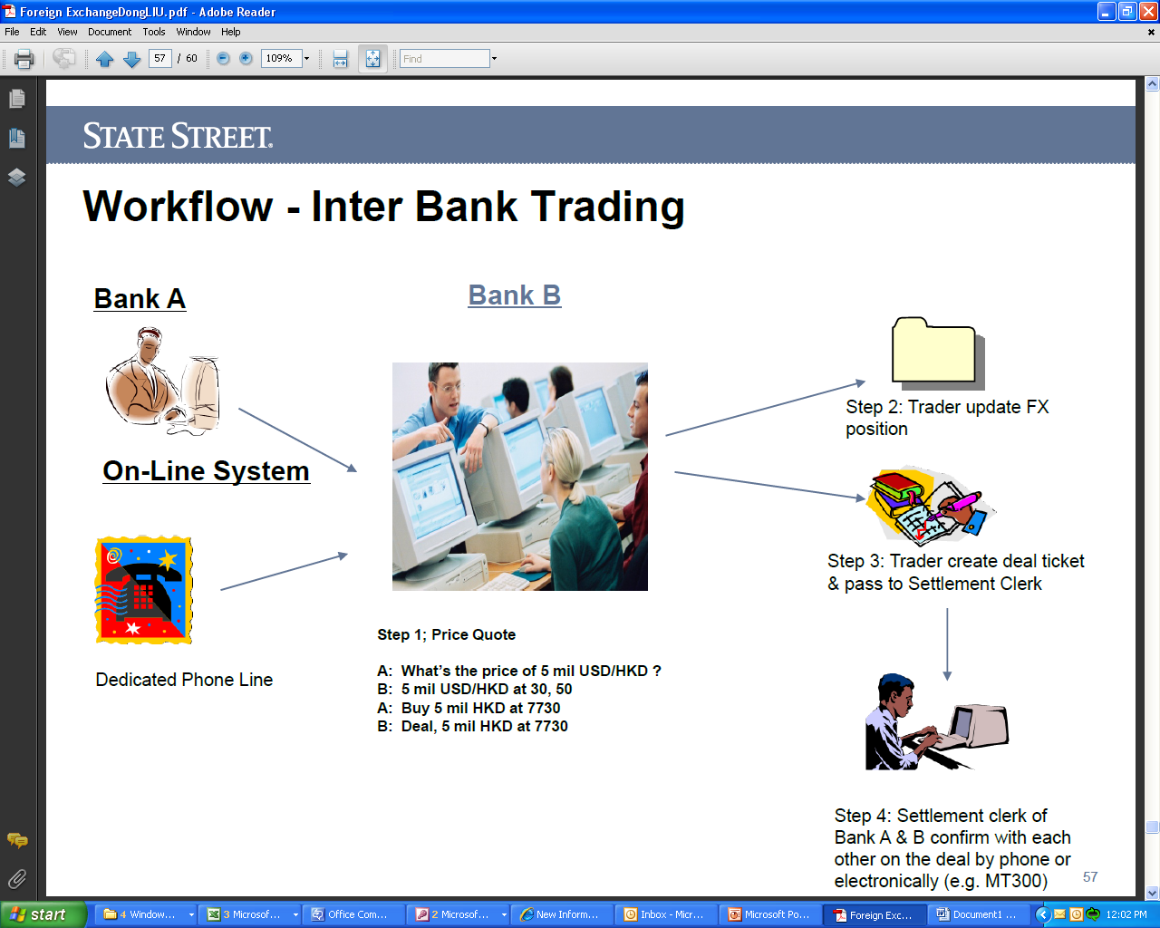

Slide 65
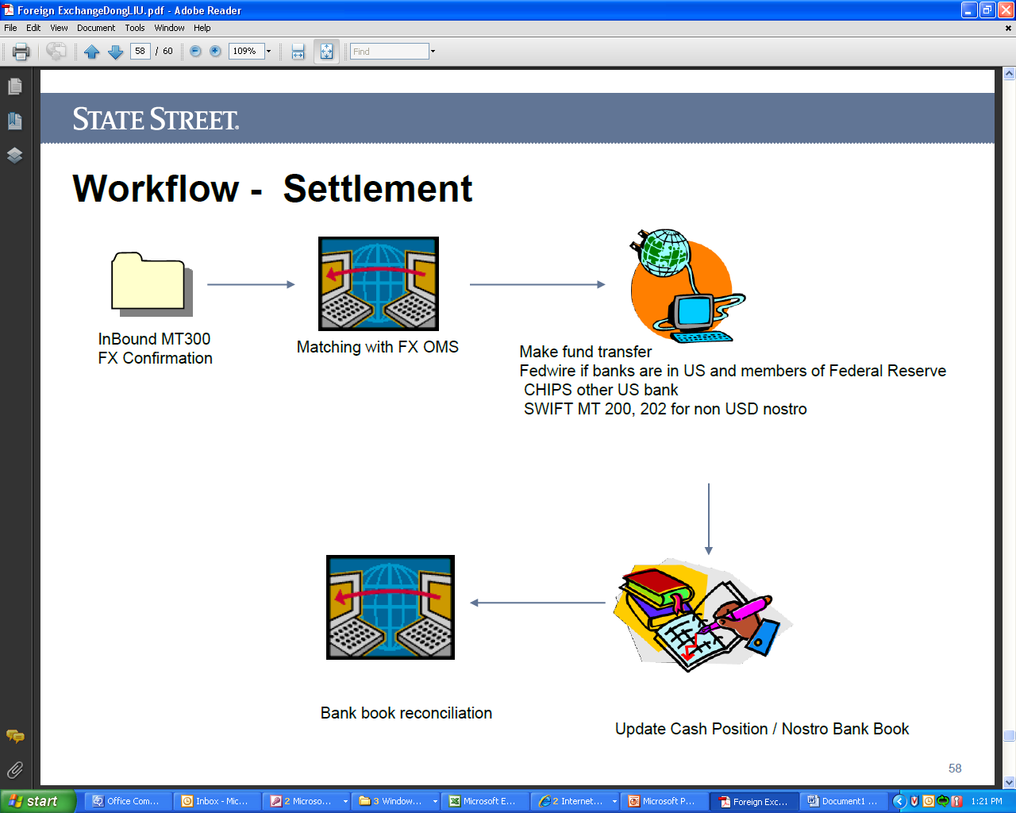

Slide 66
Conclusion
The foreign exchange market is by far the largest financial market in the world.
Currency traders trade currencies for spot and forward delivery.
Exchange rates are by convention quoted against the U.S. dollar, but cross-rates can easily be calculated from bilateral rates.
Triangular arbitrage forces the cross-rates to be internally consistent.
The euro has enhanced trade within Europe, and the currency has the potential of becoming a major world currency.

